Slide 1
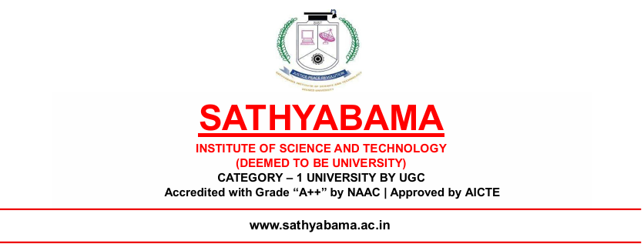
AI-BASED PLANT DIAGNOSIS RECOVERY ROADMAP AND HARVEST PROFIT FORECASTING TOOL
SELVA KUMAR P - 42120202
SRI HARI R - 42120219
Guide
DR. P. JEYANTHI M.E.,PH.D.,
PROFESSOR

Slide 2
ABSTRACT
In modern agriculture, plant diseases and environmental stressors significantly reduce crop yield and farmer profitability. Conventional manual diagnosis methods are often time-consuming, subjective, and prone to errors, resulting in delayed corrective actions. To address these challenges, this work presents an AI-based plant diagnosis system that integrates real-time full-plant scanning and image capture using camera-based inputs for accurate disease detection. The proposed system analyzes plant health conditions, generates a step-by-step recovery roadmap, and estimates potential harvest profit by considering crop type, cultivation area, expected yield, market price, and production costs. Experimental results demonstrate reliable disease identification and accurate profit forecasting, highlighting the system’s effectiveness for practical smart farming and decision-support applications. The proposed approach reduces dependency on expert intervention and enables early-stage disease detection through automated analysis. By combining plant health assessment with economic forecasting, the system supports informed decision-making for farmers.

Slide 3
INTRODUCTION
The project presents these essential contributions to the field:
The research developed an AI-based plant diagnosis system that integrates real-time full-plant scanning and camera-based image capture for accurate disease detection.
The system employs deep learning–based image analysis to automatically identify plant diseases and environmental stress symptoms at early stages.
The research designed a step-by-step recovery roadmap generation module that provides actionable treatment and prevention recommendations.
The system incorporates a harvest profit forecasting model that estimates yield and profitability using crop type, cultivation area, expected yield, market price, and production costs.
Experimental evaluation demonstrates improved diagnostic accuracy and reliable forecasting performance, making the system suitable for practical smart farming and decision-support applications.

Slide 4
LITERATURE SURVEY
Author / Year | Method Used | Data Type | Key Findings
S. Kumar et al., 2024 | CNN (Deep Learning) | Leaf Image Data | Achieved high accuracy in plant disease classification using image preprocessing and feature extraction, but limited to detection only
R. Sharma et al., 2024 | IoT + Machine Learning | Sensor Data (Temperature, Humidity, Soil) | Enabled early disease prediction and crop monitoring, but lacked recovery roadmap and profit analysis
P. Upadhyay et al., 2025 | CNN Models (VGG16, ResNet, Inception) | Image Dataset | Hybrid and ensemble models improved accuracy and robustness, but no farmer-level decision support
Y. Liu et al., 2025 | Vision Transformer (ViT) | Image Data | Provided better feature extraction and higher accuracy, but required high computational resources
M. Rahman et al., 2025 | Lightweight CNN (MobileNet) | Mobile Image Data | Developed mobile-based real-time disease detection system.

Slide 5
K. Reddy et al., 2026 | AI + IoT + Prediction Models | Sensor + External Data (Weather, Soil) | Improved crop monitoring and yield prediction, but lacked treatment/recovery roadmap
A. Patel et al., 2026 | Machine Learning (Regression Models) | Agricultural Data (Yield, Price, Cost) | Estimated crop profit effectively, but not integrated with disease detection system
S. Gupta et al., 2026 | AI + Market Prediction (ML Models) | Crop Yield + Market Price Data | Provided better crop price forecasting and decision support, but not integrated with plant disease detection

Slide 6
.
OBJECTIVES
To develop an AI-based plant diagnosis system capable of detecting plant diseases using real-time plant scanning and camera-based image inputs.
To improve the accuracy and speed of plant disease identification compared with traditional manual diagnosis methods.
To design a recovery roadmap module that provides step-by-step guidance for treating infected plants and restoring plant health.
To integrate external data sources such as weather conditions and crop market prices for better agricultural decision-making.
To estimate harvest profit by analyzing factors like crop type, cultivation area, expected yield, market price, and production costs.
To support smart farming practices by providing farmers with automated insights and recommendations.

Slide 7
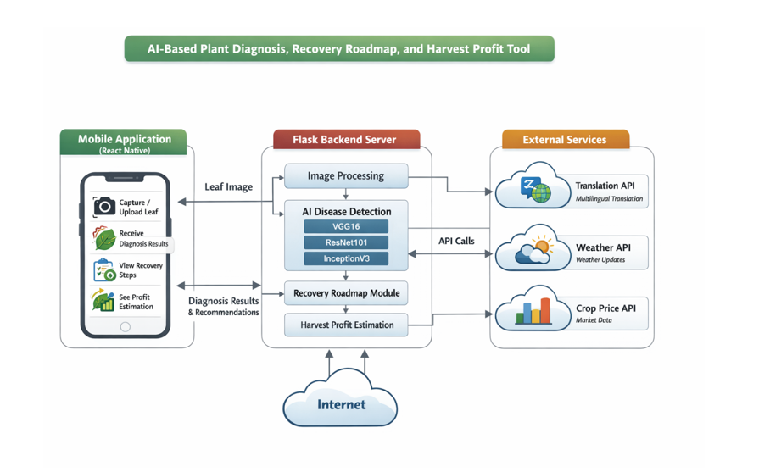
ARCHITECTURE

Slide 8
MODULE 1: MOBILE APPLICATION MODULE
The first module is the Mobile Application Module, which acts as the main user interface of the proposed system. This module is developed using React Native, enabling the application to run efficiently on smartphones. It allows farmers and agricultural users to easily interact with the system through a simple and user-friendly interface. Using the application, farmers can capture a live image of a plant leaf using the mobile camera or upload an existing image from the device gallery. The captured image is then securely transmitted to the backend server for disease analysis. After processing, the application displays the detected plant disease, recommended recovery measures, and estimated harvest profit. This module ensures accessibility, convenience, and practical usability for farmers in real agricultural environments and supports informed crop management decisions.

Slide 9
MODULE 2: IMAGE PROCESSING AND AI DISEASE DETECTION MODULE
The second module is the Image Processing and AI Disease Detection Module, which operates within the Flask-based backend server. This module receives the uploaded plant leaf images from the mobile application and begins the analysis process. Initially, several preprocessing operations such as image resizing, normalization, and noise reduction are performed to enhance the quality and consistency of the input data. These preprocessing steps ensure that the images are suitable for deep learning analysis. After preprocessing, advanced deep learning models including VGG16, ResNet101, and InceptionV3 are applied to analyze the leaf images. These convolutional neural network architectures extract significant visual features from the images and compare them with trained patterns. As a result, the system accurately identifies and classifies the type of disease affecting the plant.

Slide 10
MODULE 3: RECOVERY ROADMAP MODULE
The third module is the Recovery Roadmap Module, which provides treatment recommendations based on the disease detected by the system. Once the plant disease is identified, this module generates a structured recovery plan to assist farmers in managing and treating the affected crops effectively. It analyzes the diagnosis results and suggests suitable pesticides, fertilizers, and crop protection measures that can help restore plant health. In addition, the module provides guidance on proper irrigation, soil care, and preventive agricultural practices to reduce the risk of future infections. These recommendations are designed to be simple and practical so that farmers can easily apply them in real farming conditions. By transforming the diagnosis results into clear and actionable steps, this module supports farmers in protecting their crops, improving productivity, and minimizing potential agricultural losses.

Slide 11
MODULE 4: HARVEST PROFIT ESTIMATION AND EXTERNAL SERVICES MODULE
The fourth module is the Harvest Profit Estimation and External Services Module, which integrates various external APIs to support intelligent decision-making for farmers. This module collects useful information from multiple services such as weather APIs to obtain real-time climate updates, crop price APIs to monitor current market values, and translation APIs to provide multilingual support for different users. By combining these external data sources, the system analyzes important agricultural factors such as crop condition, weather patterns, and market demand. Based on this analysis, it estimates the potential harvest profit that farmers can expect from their crops. The information is presented in a simple and understandable format through the mobile application. This module helps farmers plan harvesting schedules, choose the best time to sell their produce, and improve overall profitability.

Slide 12
PROPOSED ALGORITHM
Input: Plant leaf image captured from mobile camera, crop type, cultivation area, production cost.
Output: Detected plant disease, recovery roadmap, estimated harvest profit.
Step 1: Image Acquisition
Capture the plant leaf image using the mobile application camera.
Upload the image to the backend server for processing.
Step 2: Image Preprocessing Resize the input image to a fixed resolution. Apply noise reduction and image normalization. Convert the image into a format suitable for deep learning models.

Slide 13
PROPOSED ALGORITHM
Step 3: Feature Extraction and Disease Detection Feed the preprocessed image into trained CNN models such as VGG16, ResNet101, or InceptionV3. Extract important visual features from the leaf image. Classify the plant condition into healthy or specific disease category.
Step 4: Recovery Roadmap Generation Retrieve treatment recommendations from the knowledge database. Generate a step-by-step recovery roadmap including pesticides, fertilizers, irrigation, and preventive measures.
Step 5: External Data Collection Fetch weather information using weather APIs. Retrieve current crop market prices using crop price APIs.

Slide 14
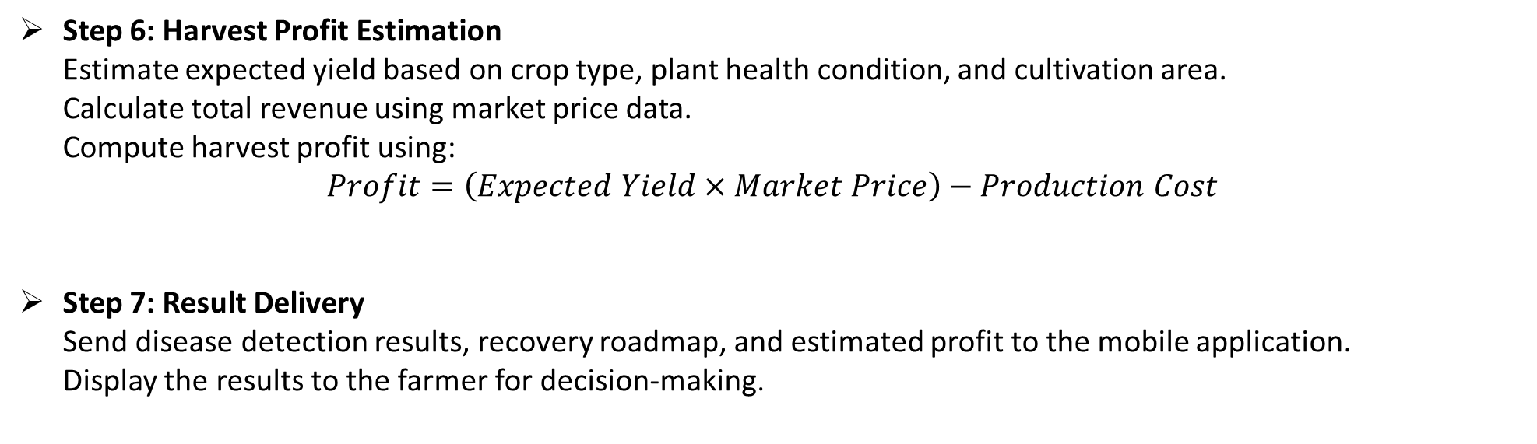
PROPOSED ALGORITHM
Step 6: Harvest Profit Estimation Estimate expected yield based on crop type, plant health condition, and cultivation area. Calculate total revenue using market price data. Compute harvest profit using:
$$Profit=\left(Expected Yield×Market Price\right)−Production Cost$$
Step 7: Result Delivery Send disease detection results, recovery roadmap, and estimated profit to the mobile application. Display the results to the farmer for decision-making.

Slide 15
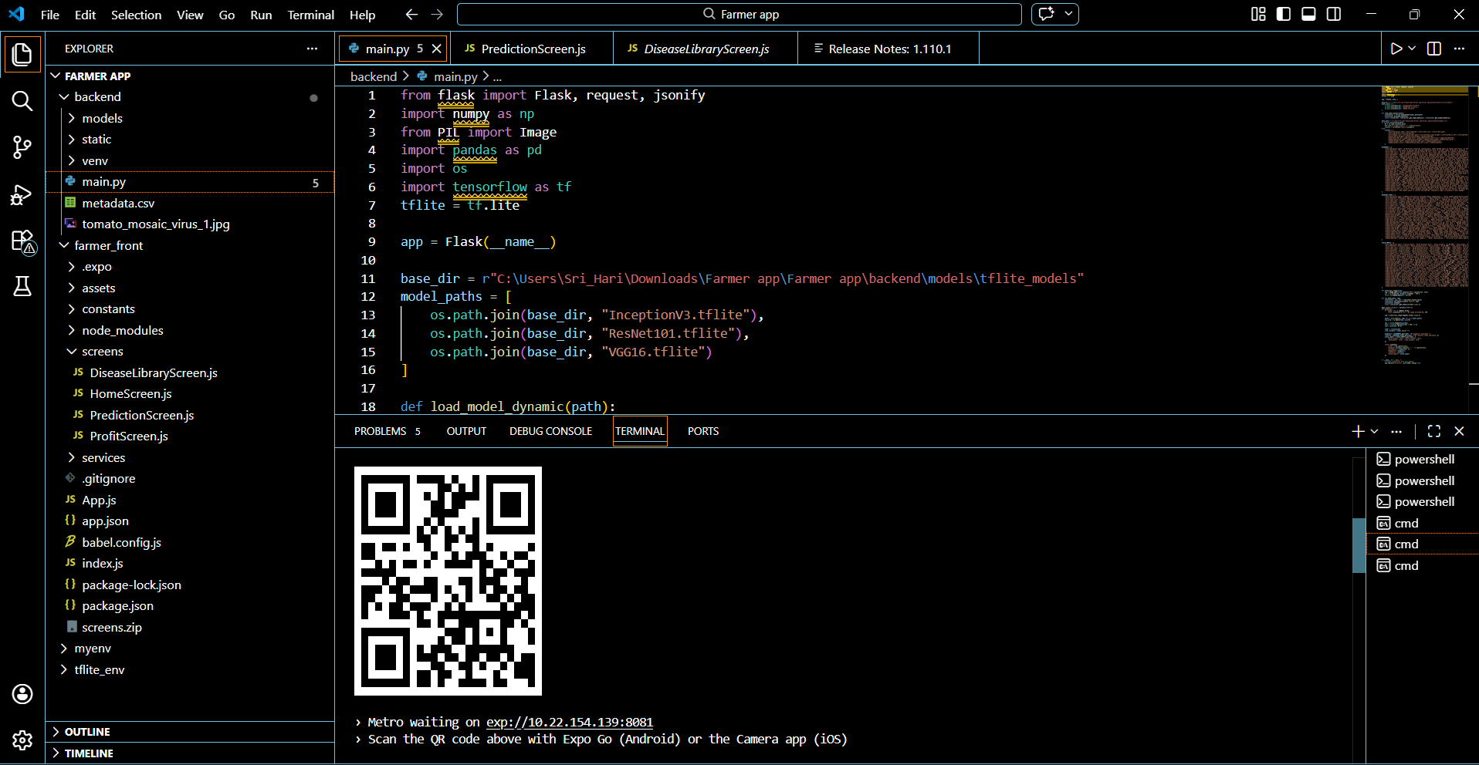
OUTPUT

Slide 16
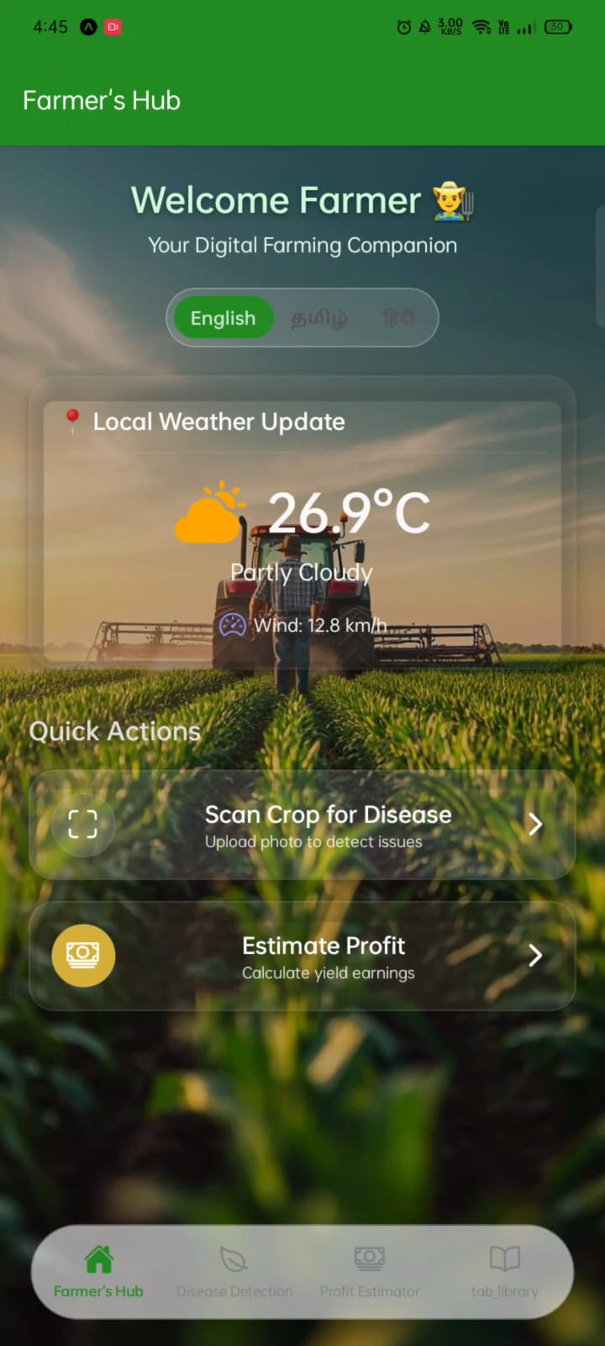
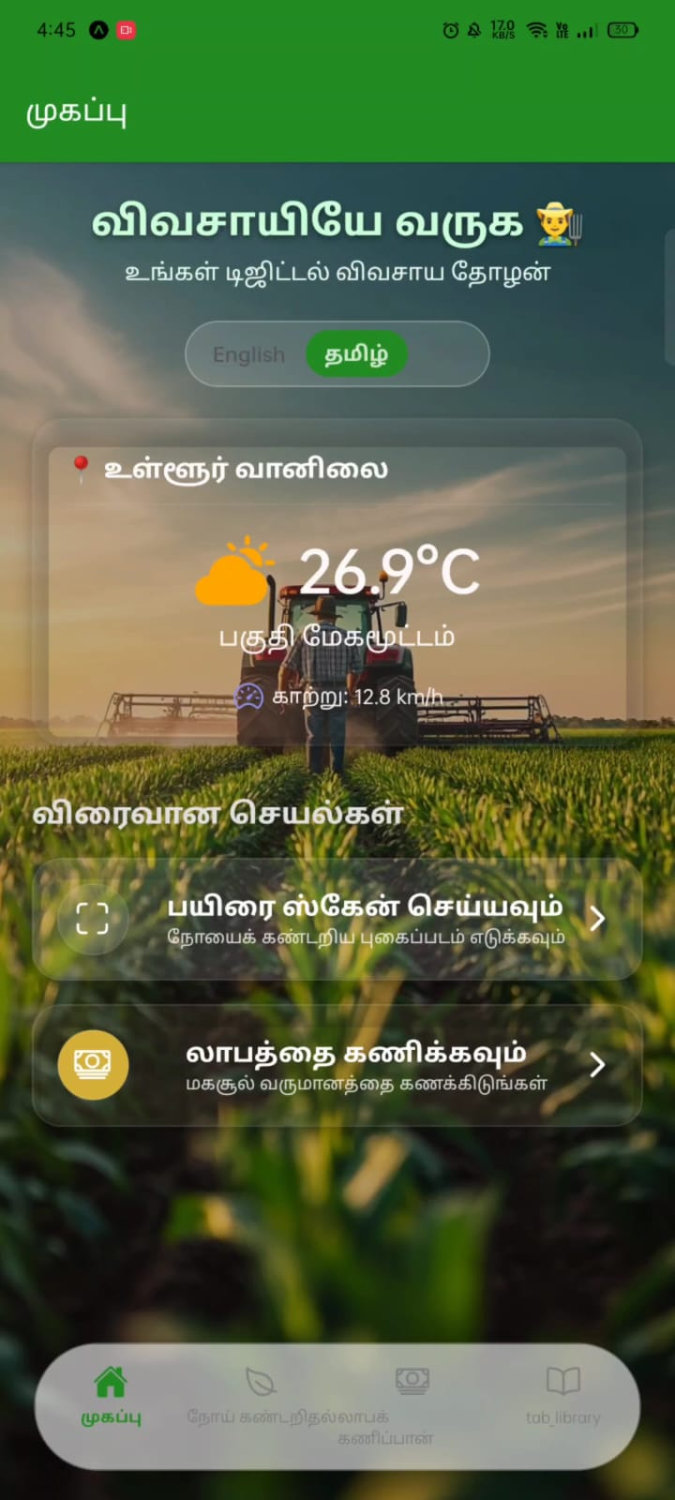
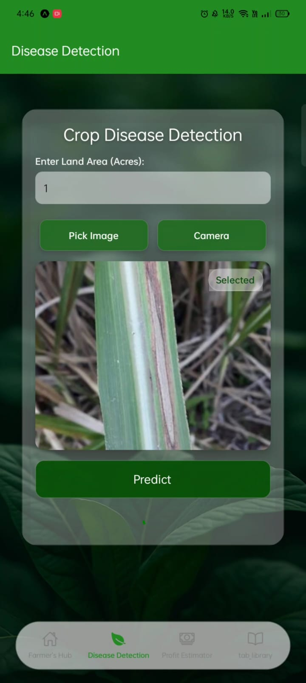
OUTPUT

Slide 17
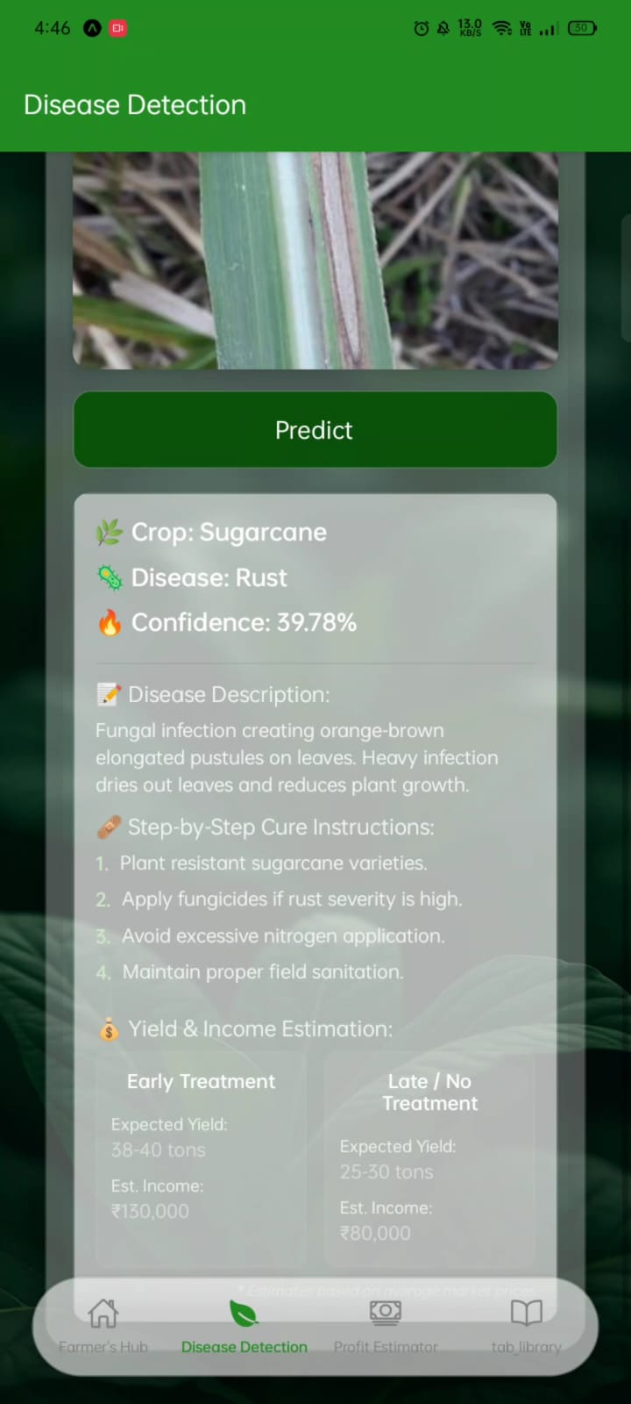
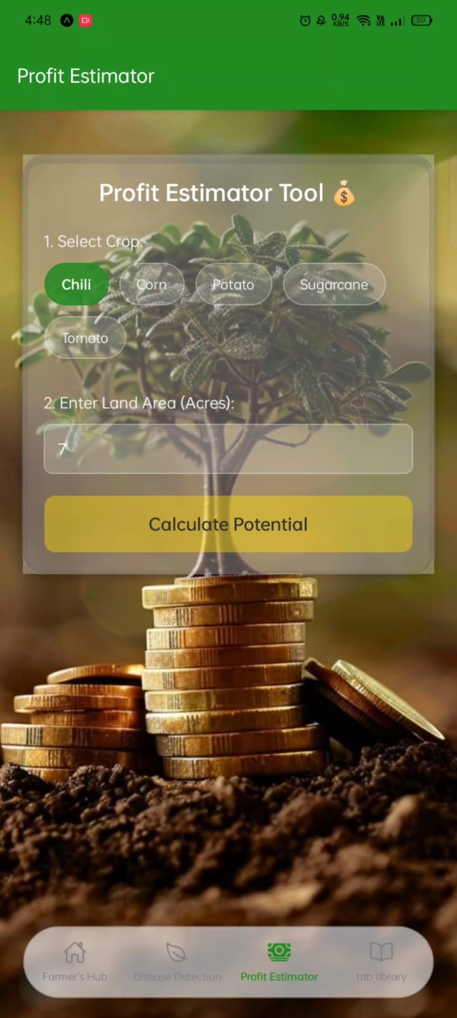
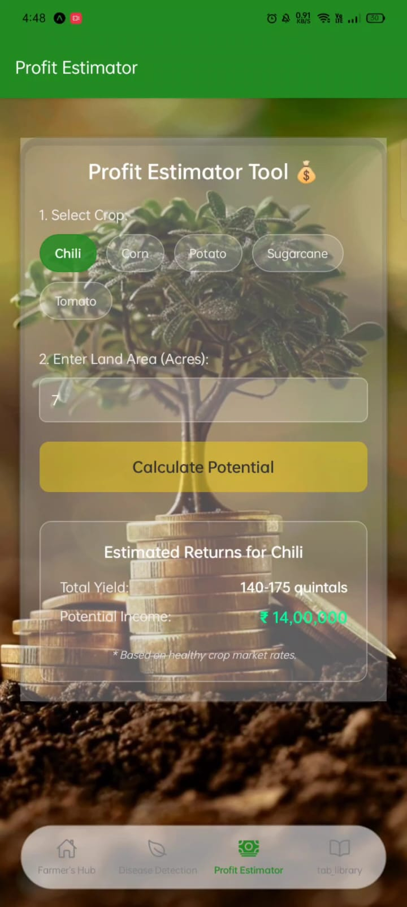
OUTPUT

Slide 18
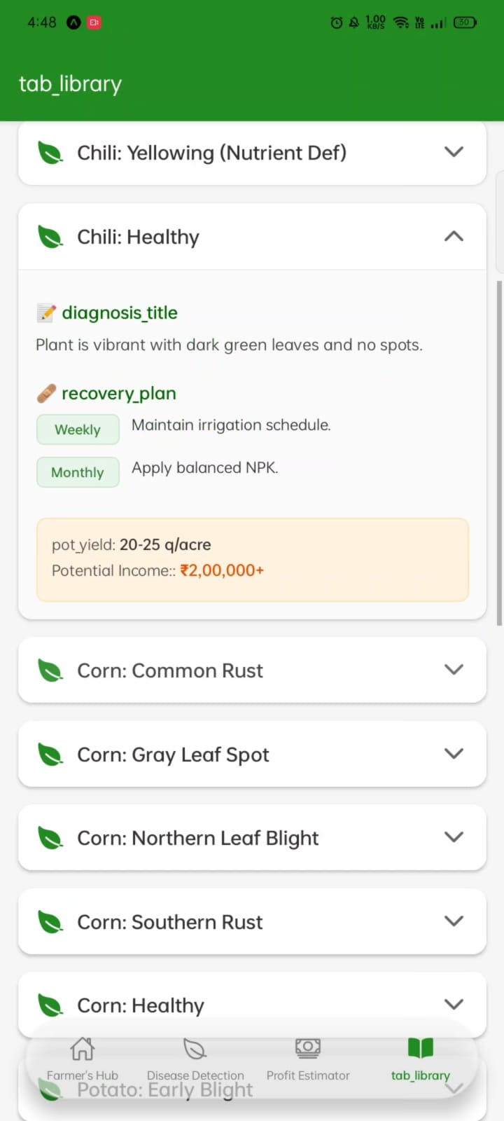
OUTPUT

Slide 19
RESULTS AND DISCUSSION
The proposed AI-based plant diagnosis system was successfully implemented and evaluated using real-time plant leaf images captured through the mobile application. The system integrates disease detection, recovery roadmap generation, and harvest profit forecasting into a single platform, providing a complete smart farming solution.
The deep learning models, namely VGG16, ResNet101, and InceptionV3, demonstrated strong performance in identifying plant diseases. After preprocessing steps such as resizing, normalization, and noise reduction, the models were able to accurately classify plant conditions into healthy and diseased categories, even under varying environmental conditions like lighting and background noise. This confirms the effectiveness of convolutional neural networks in agricultural image analysis.
The mobile application module provided a user-friendly interface, enabling farmers to easily capture or upload plant images and receive instant results. The system outputs included detected disease type, recommended recovery measures, and estimated harvest profit, ensuring ease of use and practical applicability in real-world farming environments.

Slide 20
RESULTS AND DISCUSSION
The harvest profit estimation module analyzed multiple parameters such as crop type, cultivation area, expected yield, production cost, and market price. By integrating external APIs for weather updates and market trends, the system provided realistic and useful profit predictions. This enables farmers to make informed decisions regarding harvesting time and selling strategies, ultimately improving profitability.
The overall results indicate that the proposed system significantly improves traditional plant disease diagnosis methods by providing faster, more accurate, and automated analysis. Unlike existing systems that focus only on disease detection, this system combines detection, recovery guidance, and economic forecasting, making it a comprehensive decision-support tool.
“Our system not only detects plant diseases accurately but also provides recovery solutions,
profit forecasting, making it a complete AI-based smart farming decision support system.”

Slide 21
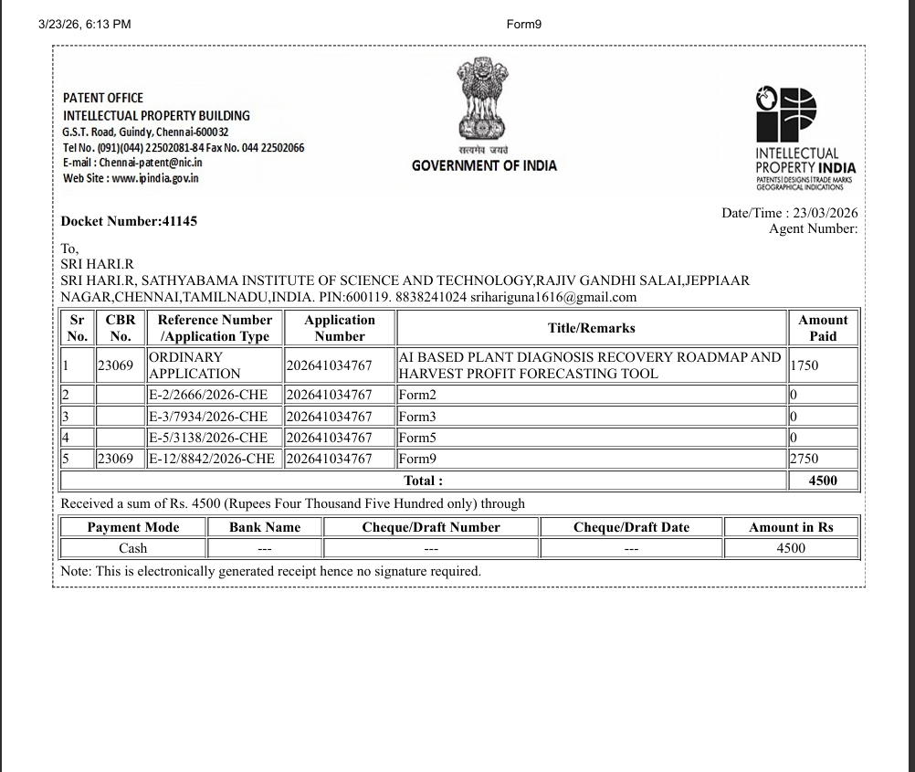
PAYMENT PROOF

Slide 22
REFERENCE
R. Febrianda, “Mobile App Technology Adoption in Indonesia’s Agricultural Sector. An Analysis of Empirical View From Public R&D Agency,” STI Policy and Management Journal, vol. 6, no. 1, Jul. 2021, doi: 10.14203/stipm.2021.302.
S. Kumar, A. Verma, and P. Singh, "Digital Agriculture: Transforming the Supply Chain," International Journal of Agricultural Research, Vol. 45, No. 3, pp. 121-135, 2023. DOI:10.1007/s00453-022-01152-4
P. Agarwal, "AI-Based Demand Forecasting for Crops," International Journal of Agricultural Informatics, Vol. 16, No. 4, pp. 55-70, 2023. DOI:10.1016/j.agrinf.2023.06.004
L. Singh, "Enhancing Direct Market Access Through Mobile Apps," IEEE Smart Agriculture Conference, IEEE, India, pp. 110-118, 2023.
Y. Liu, X. Ma, L. Shu, G. P. Hancke, and A. M. Abu-Mahfouz, ‘‘From industry 4.0 to agriculture 4.0: Current status, enabling technologies, and research challenges,’’ IEEE Trans. Ind. Informat., vol. 17, no. 6, pp. 4322– 4334, Jun. 2021.

Slide 23
REFERENCE
E. Hossain, M. F. Hossain, and M. A. Rahaman, “A Color and Texture Based Approach for the Detection and Classification of Plant Leaf Disease Using KNN Classifier,” 2nd Int. Conf. Electr. Comput. Commun. Eng. ECCE 2019, pp. 1–6, 2019, doi: 10.1109/ECACE.2019.8679247.
[M. Meenakshi et al., “A Framework Design of ML Classifier Algorithm for Retrieve the Information About the Drugs and its Quality,” 2024 4th Int. Conf. Adv. Comput. Innov. Technol. Eng., pp. 409–412, 2024, doi: 10.1109/ICACITE60783.2024.10616883.
D. G. V, “Surface Roughness Prediction in Turning of Monel K 500 using DWT Technique,” 2023 2nd Int. Conf. Appl. Artif. Intell. Comput., no. Icaaic, pp. 1660–1665, 2023, doi: 10.1109/ICAAIC56838.2023.10140643.
S. Kamal et al., “FCN Network-Based Weed and Crop Segmentation for IoT-Aided Agriculture Applications,” Wirel. Commun. Mob. Comput., vol. 2022, 2022, doi: 10.1155/2022/2770706.
B. Venkataramanaiah, R. M. Joany, B. Singh, T. Vinoth, G. R. S. Krishna, and T. J. Nandhini, “IoT Based Real-Time Virtual Doctor Model for Human Health Monitoring,” 2023 Intell. Comput. Control Eng. Bus. Syst. ICCEBS 2023, pp. 1–5, 2023, doi: 10.1109/ICCEBS58601.2023.10448557.

Slide 24
THANK YOU

